Slide 1
World Happiness Report Analysis
2015-2019
By - Chen,Jiayi
Gao,Emma
Patubo,Mildred
Sanchez,Elisa
Yu,Victor

Slide 2


Slide 3
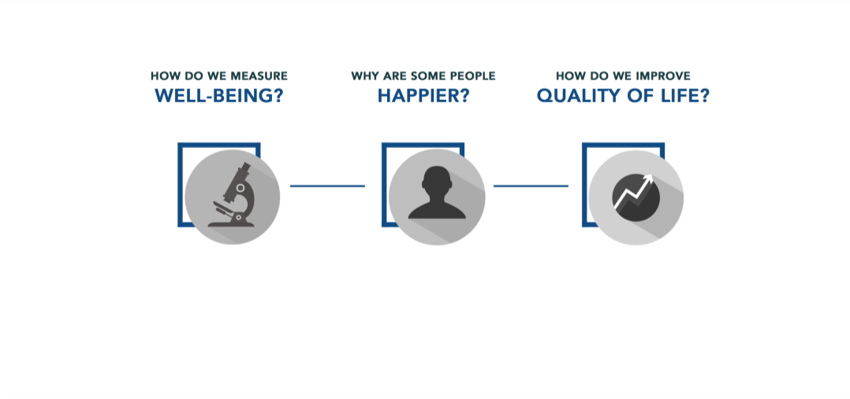

Slide 4
Why world happiness report?
We want to understand what makes a great life and share the information with people around us and inform the leaders as to the activities that they need to do in order to improve people’s lives. Measuring happiness matters – Happiness is important and if something is really important it needs to be measured if it’s going to be taken really seriously by people. It’s a lesson for leaders to look around and see in which countries people do regard themselves as very happy and then ask why and apply it in our country. Gallup World Poll does provide the report on a uniform comparable basis right across the world to measure how people value their own lives and that’s the single most important statistic in the world.

Slide 5
Data source
Gallup World Poll. Since 2012, Gallup’s World Poll has been a primary source of global data behind the life satisfaction rankings released in SDSN's highly publicized World Happiness Report. So far, SDSN has published eight reports. Our analysis contains report data from 2015 to 2019.

Slide 6
Analysis focused on 6 main factors based on the poll results from 155 countries
1. GDP per capita: based on Purchasing power parity (PPP)
2. Social Support: having someone to count on in times of trouble
3. Healthy life expectancy: from WHO data repository
4. Freedom to make life choices: satisfaction level
5. Generosity: donation etc.
6. Perceptions of corruption: government corruption and business corruption

Slide 7
Questions we hope to get answer with the data
How 6 main factors impacting happiness scores (linear regression)
Machine learning to see if countries are on the right track to achieve happiness
What is impacting the ranking and why nordic countries appears to be the happiest

Slide 8
Tools will be used to create final dashboard
pgAdmin4
Jupyter notebook
Tableau
Html
Javascript
D3
Plotly
Matplotlib

Slide 9
Data exploration phase
We cleaned the data up by using ETL process
Joint tables with pgAdmin
We have tried to use countries happiness score over 5 years to do machine learning but it was not successful with only score as a factor.
We moved on to use 6 happiness factors to happiness score relationship with machine learning model and it was a success

Slide 10
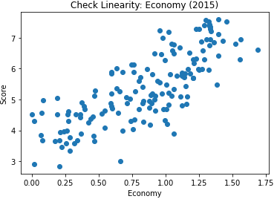
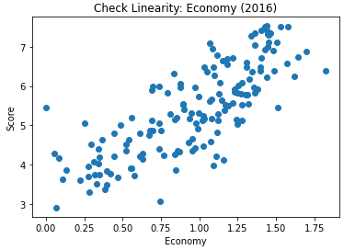
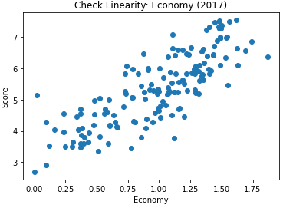
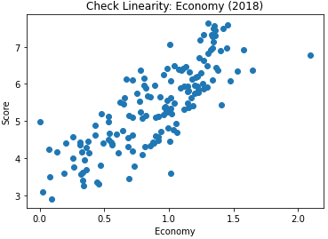
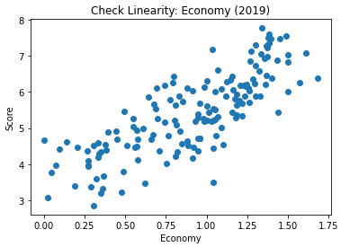
Analysis phase - Economy and Happiness
Regression test is showing clear linear relationship between economy and happiness score

Slide 11
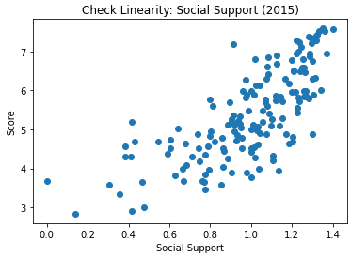
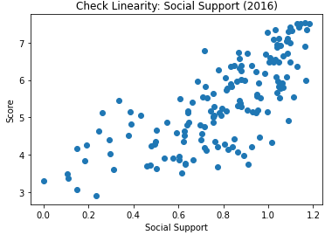
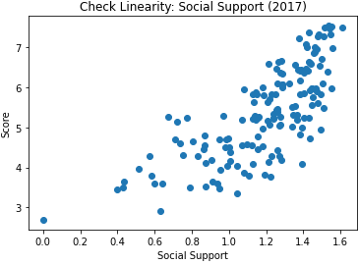
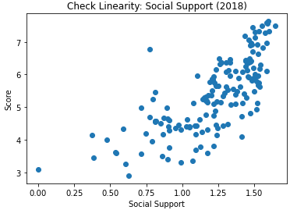
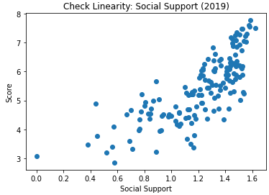
Analysis phase - Social Support and Happiness
Regression test is showing clear linear relationship between social support and happiness score

Slide 12
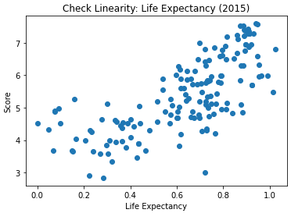
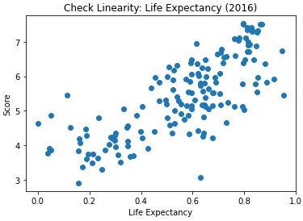
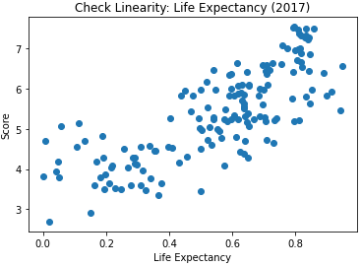
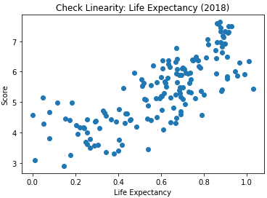
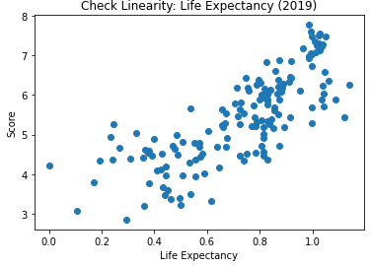
Analysis phase - Life Expectancy and Happiness
Regression test is showing clear linear relationship between life expectancy and happiness score

Slide 13
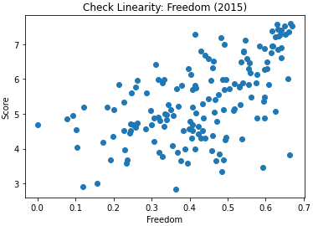
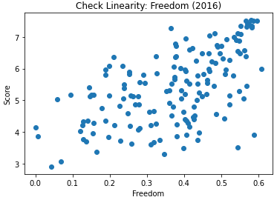
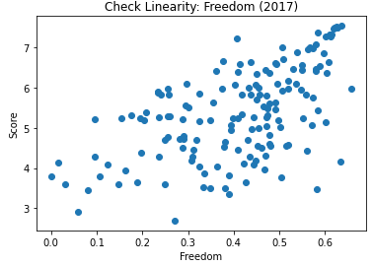
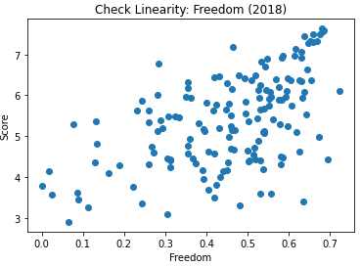
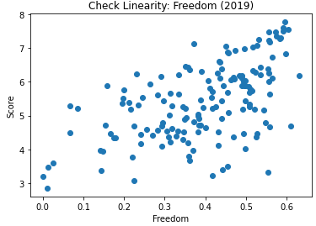
Analysis phase - Freedom and Happiness
Regression test is showing a linear relationship between freedom and happiness score

Slide 14
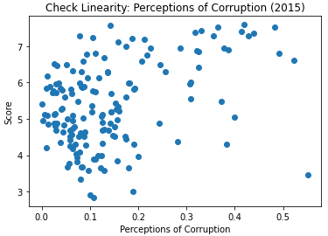
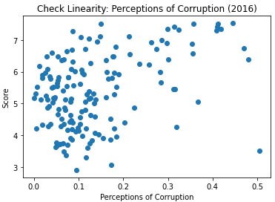
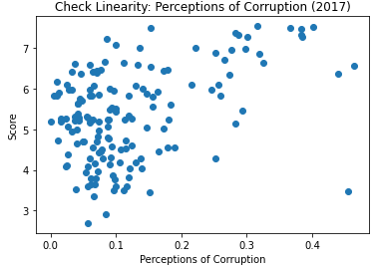
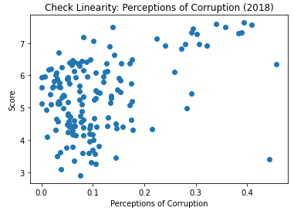
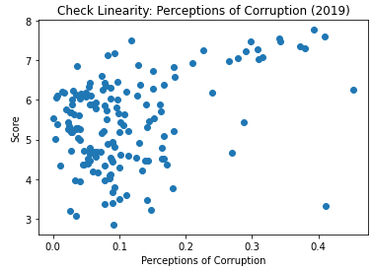
Analysis phase - Corruption and Happiness
Regression test is showing there is not a linear relationship between corruption and happiness score

Slide 15
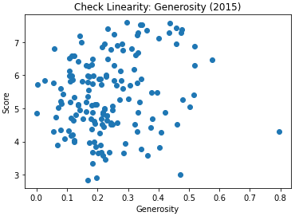
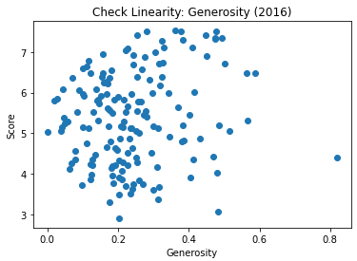
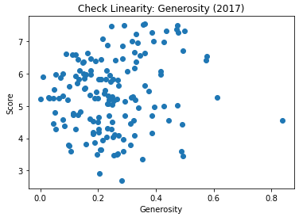
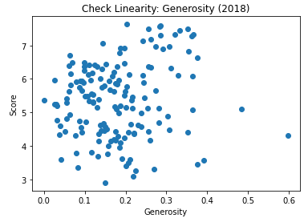
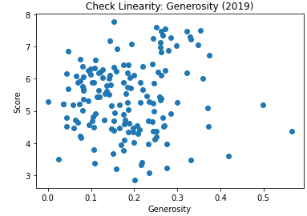
Analysis phase - Generosity and Happiness
Regression test is showing there is not a linear relationship between generosity and happiness score

Slide 16
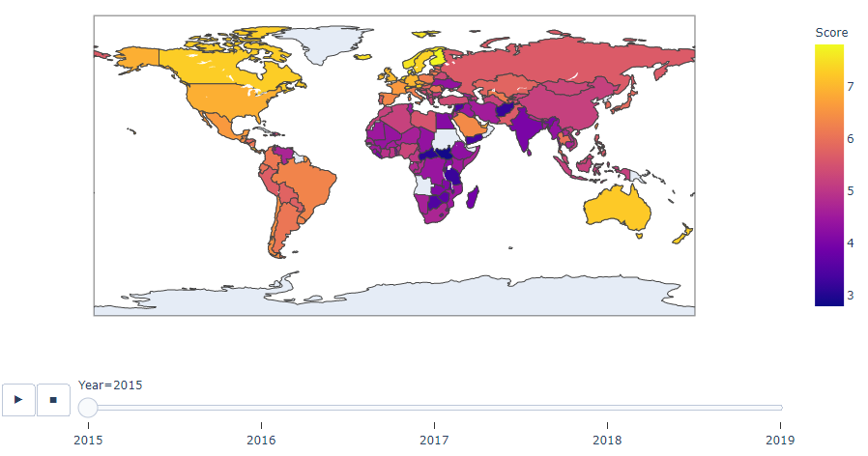
Analysis phase - visualization of world happiness map
Created interactive map with plotly - the happiest country is in yellow color and the least happy country is in dark purple.

Slide 17
Interactive elements
We will be working on plotly with html to design a dashboard that allows us to filter by country and by happiness factor. There will also be interactive graphs on the html website.
We are also planning to use Tableau to design our interactive dashboard.

